Slide 1
COMPANY PROFILE
IN DIGITAL WORLD
LARK HI-TECH LIMITED

Slide 2
Company Overview
01
About Us
Milestones
Vision & Mission
Our Value Propositions
Branches
Core Business Area
Contents
02
Payment Solution
Consumable Products for ATM, CRM & POS
Money Handling Equipment
Security Products
Upcoming Equipment of Next Generation Banking
Core Business Area
03
EMV Personalization Solutions
Card Management System
ATM Monitoring Solutions

Slide 3
COMPANY OVERVIEW
LARK HI-TECH LIMITED

Slide 4
ABOUT US
LARK HI-TECH LIMITED is a limited liable company with a team of dedicated members who have extensive experience from various related fields, LARK is eager to impart and implement their knowledge and expertise towards any project. LARK has various renowned brand products and solution to satisfy needs in the Banking field.
HISTORY
"LARK" is focusing to build market presence through supplying a good quality and competitive alternative to the market leaders and by controlling our administrative and operational costs, which in most cases has led to savings by our customers – we provide solutions for the Banking industry.
We have solutions for all kind of cards including contact and contactless cards for payments, Money handling solution & equipment, MICR handling solution & equipment, Online Cash Deposit Machine, POS Machine & ATM, POS, CDM Consumables, etc..

Slide 5
Milestones
2012
2014
Money Handling
Equipment
Banking Security
Products
2019
2015
Online CDM,
2013
Note Sorting
Machine
EMV Chip Card
& Solution
2011
MS Bank
Cards
2018
2009
2016
Contactless Cards
With Solution & Embossing Machine
Founded
MICR Cheque Handling
Products
2010
ATM
Consumables
2017
ATM Monitoring,

Slide 6
Vision
Our vision is to take our IT industry to the international level by providing quality services.
Mission
To empower our customers, employees, partners and communities by providing the finest products, services and practices.

Slide 7
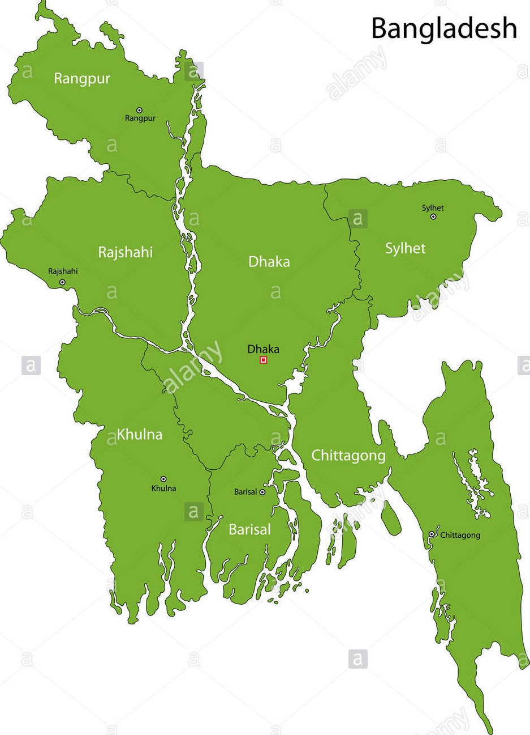
With the commitment of supporting it’s client for business expansion LARK ensures first level support from local area.
To meet the customer requirements LARK have seven branch offices while the Corporate Head Office located in Dhaka.

Slide 8
CORE BUSINESS AREA
LARK HI-TECH LIMITED

Slide 9
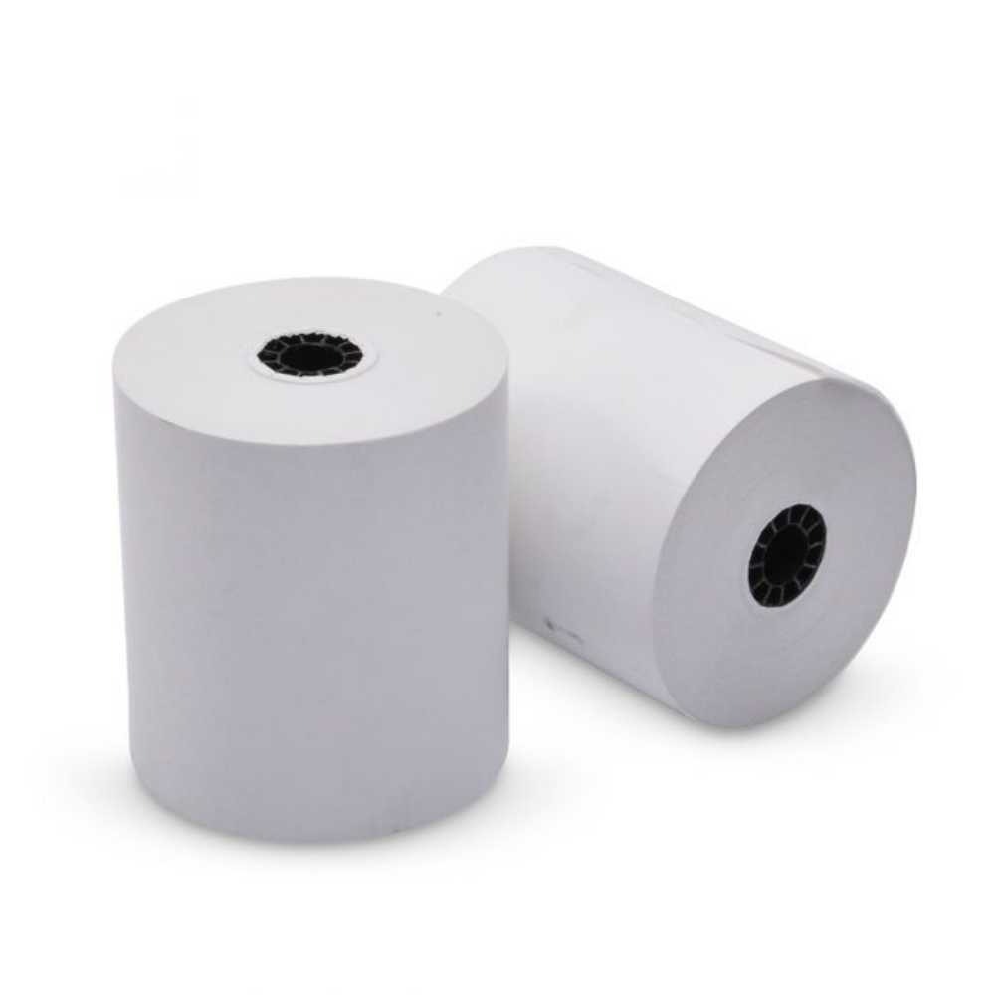
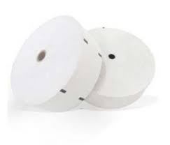
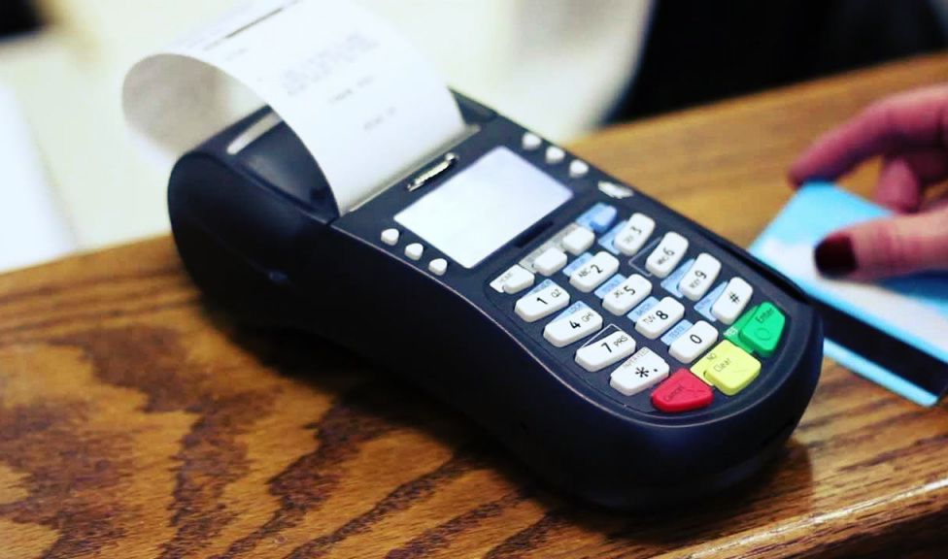
ATM Receipt Paper Roll
ATM Journal Paper Roll
POS Thermal Paper Roll
CDM Thermal Paper Roll
CRM Thermal Paper Roll
BANK CONSUMABLES
Consumables for Banking Payment System
ATM, CDM & POS.

Slide 10
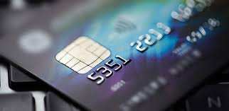
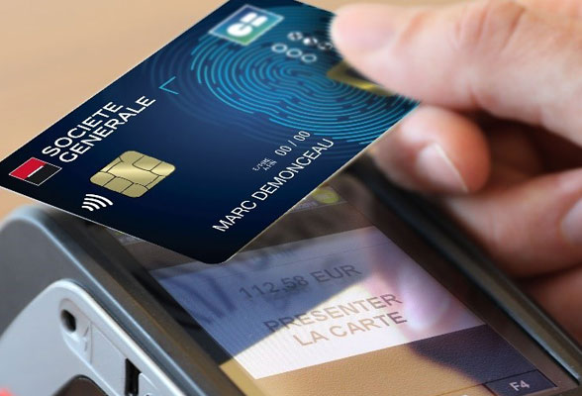
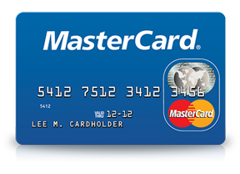
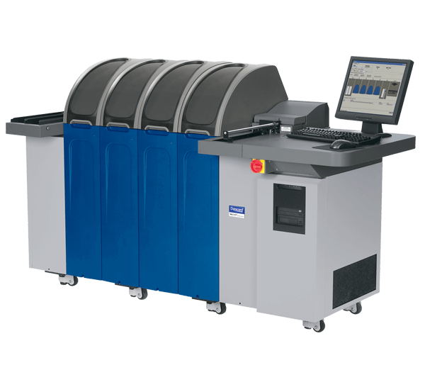
Dual Interface Card
EMV Chip Card
Personalization Solution for EMV & DI Cards
Proprietary Plastic Card.
Card Embossing Machine.
HSM
PAYMENT SOLUTIONS
Dual interface & EMV Chip Card ensure a more secure and reliable banking platform for end user.

Slide 11
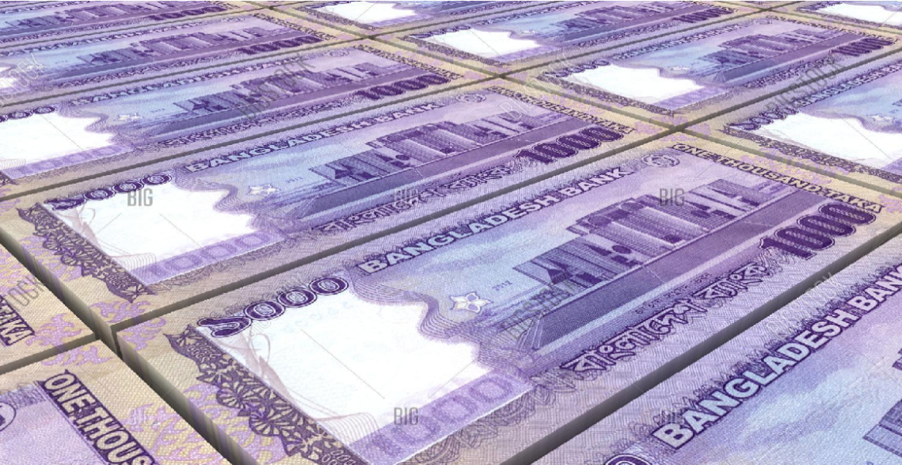
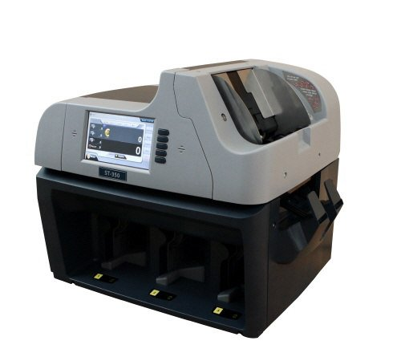
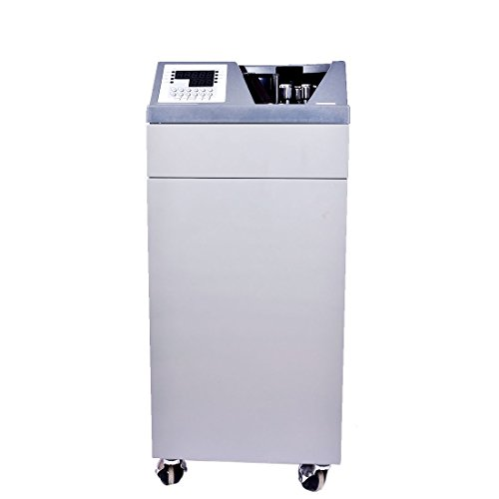
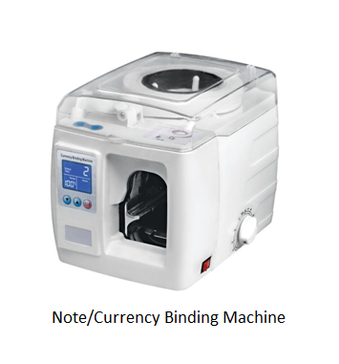
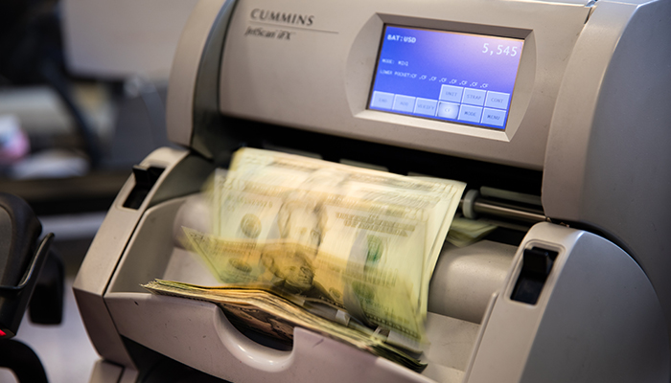
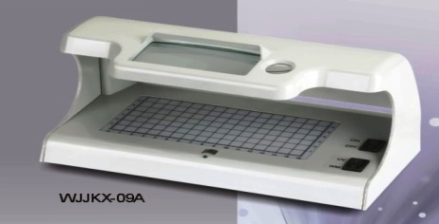
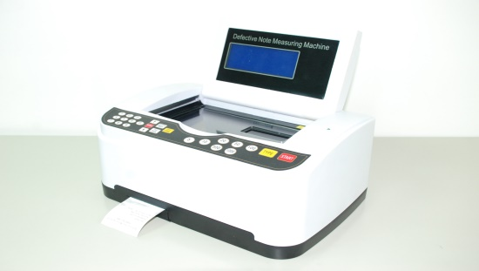
Note Sorting Machine
Note Counting Machine
Note Binding Machine
Fake Note Detector Machine
Note Measurements Machine
MONEY HANDLING PRODUCTS
To protect the banking consumers from fraud and fake notes bank notes counter and detectors

Slide 12
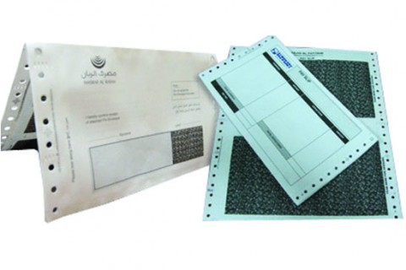
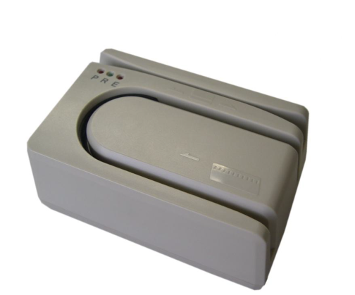
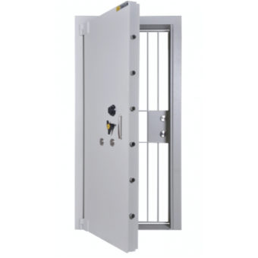
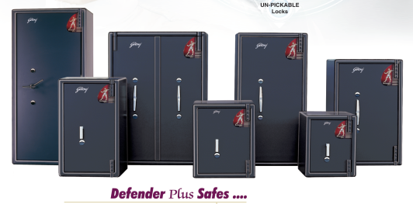
PIN Mailer
CBS-1 Paper
Vault Room Door
Heavy Duty Vault
MICR Reader
Boarding Card & Tag
SECURITY PRODUCTS

Slide 13
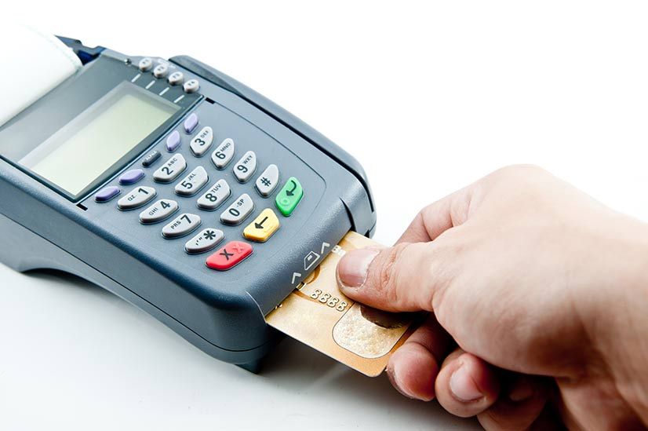
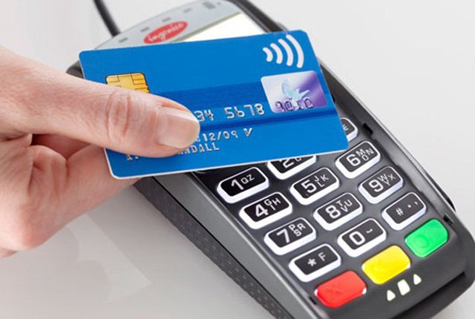
LARK, A pioneering venture in the Smart Card industry in Bangladesh. We are capable of providing all types of Bank Card both Magnetic strip and Chip-based Cards with latest Software Application.
Contact Card
Contactless Card
Kona
Gemalto
Lagos
Ubivelox
Goldpac

Slide 14
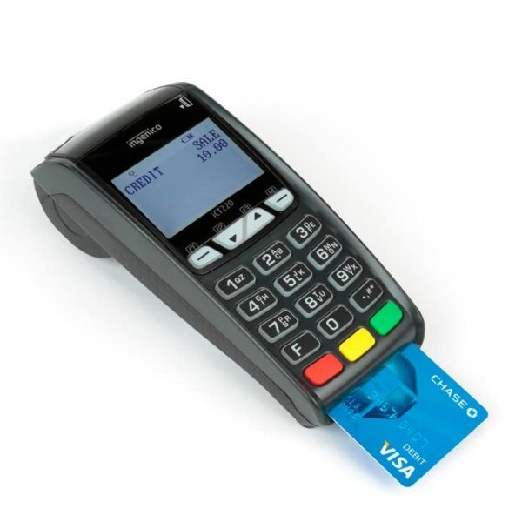
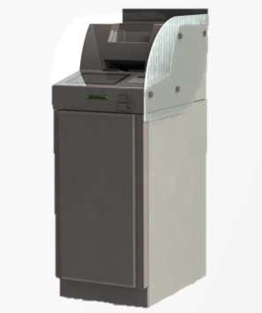
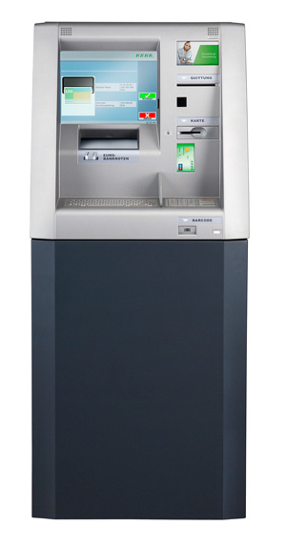
NEW ARRIVALS & UPCOMING
Online Cash Deposit Machine
POS Terminal
Cash Recycler Machine
Switching Solution

Slide 15
PARTNERSHIP ON SHARED VISION
LARK HI-TECH LIMITED

Slide 16
Whom we partner with?
LARK HI-TECH LIMITED has exclusive partnership with the leading global companies operating in the core technology domains for bank.
Goldpac Fintech Hong Kong Ltd.
Godrej Security Solutions
SPL GROUP USA, INC.
Maxsell , India
X Infotech Ltd. Latvia
MF Group – CIM, Italy
Tele Paper, Malaysia
Zhejiang Kaixun Mechanical & Electrical Co. Ltd
Mitsubishi Electric, Japan
Trans-World, Taiwan
OpenWay Group. Belgium

Slide 17
MARKET REFERENCES
LARK HI-TECH LIMITED

Slide 18
Our Valuable Clients

Slide 20
CCONTACT US
LARK HI-TECH LIMITED
Shakh Centre (6th Floor), 56,
Purana Paltan, Dhaka -1000,
Bangladesh.
T: +8802-956 3870,
M: +88 016784 20104
info@lark-bd.com
www.lark-bd.com

